Slide 1
Module 1: Introduction to Single Cell RNA-Seq
NCSU scRNA Workshop, 2024
Bruce Corliss, PhD and Allison Dickey, PhD

Slide 2
Outline
Advances and Popularity
Questions and Applications
scRNA-Seq Experiment Workflow
scRNA-Seq Technologies
scRNA-Seq Computational Workflow
Atlas Datasets

Slide 3
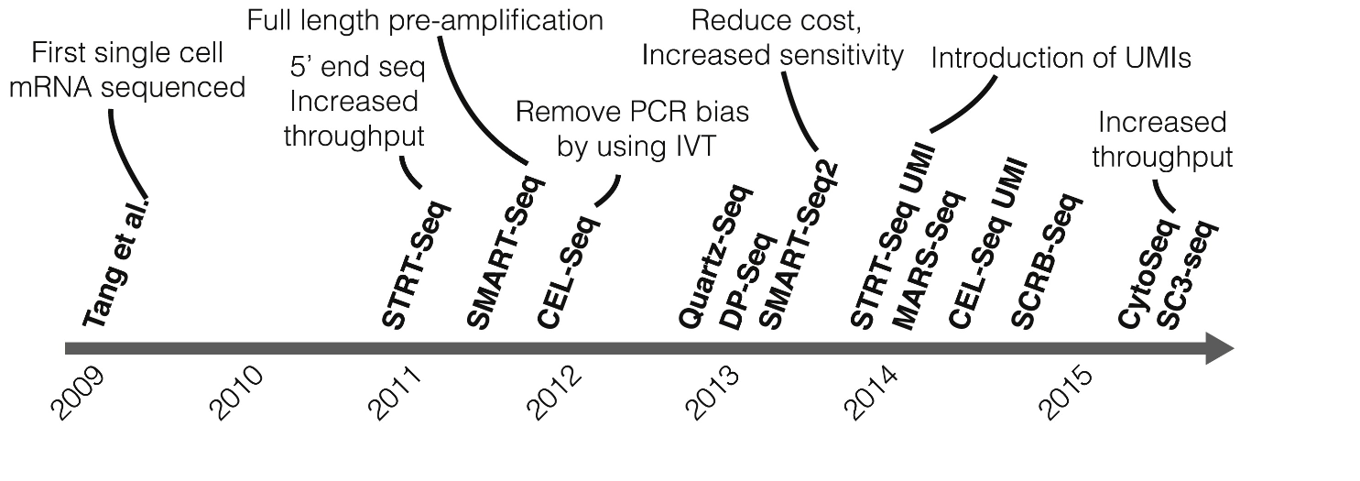
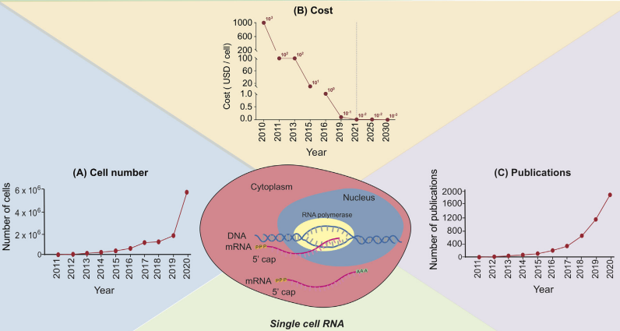
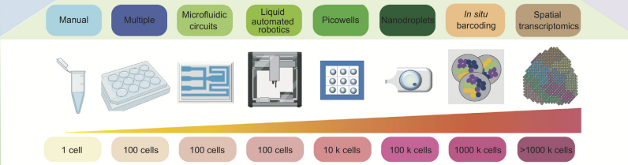
Rapid Rise of Single Cell RNA-Seq in Research
Kolodzeijczyk. Mol. Cell (2021). 58:4 P610-620.
Jovic. Clin Transl Med. 2022 Mar; 12(3): e694.
Notes:
https://www.ncbi.nlm.nih.gov/pmc/articles/PMC8964935/

Slide 4
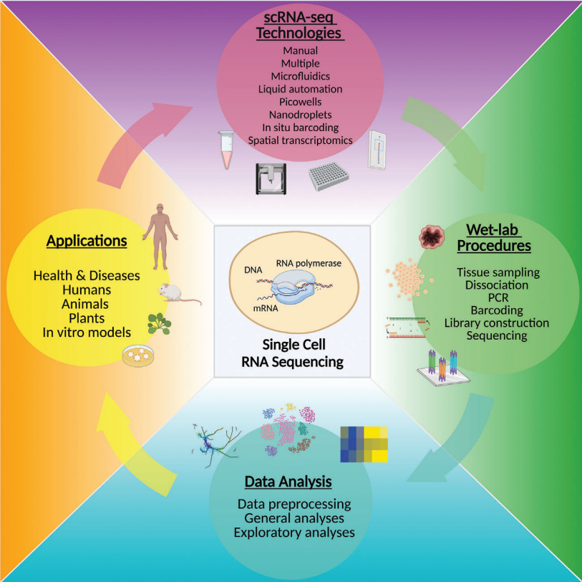
scRNA-Seq Research Lifecycle
Jovic. Clin Transl Med. 2022 Mar; 12(3): e694.
Notes:
https://www.ncbi.nlm.nih.gov/pmc/articles/PMC8964935/

Slide 5
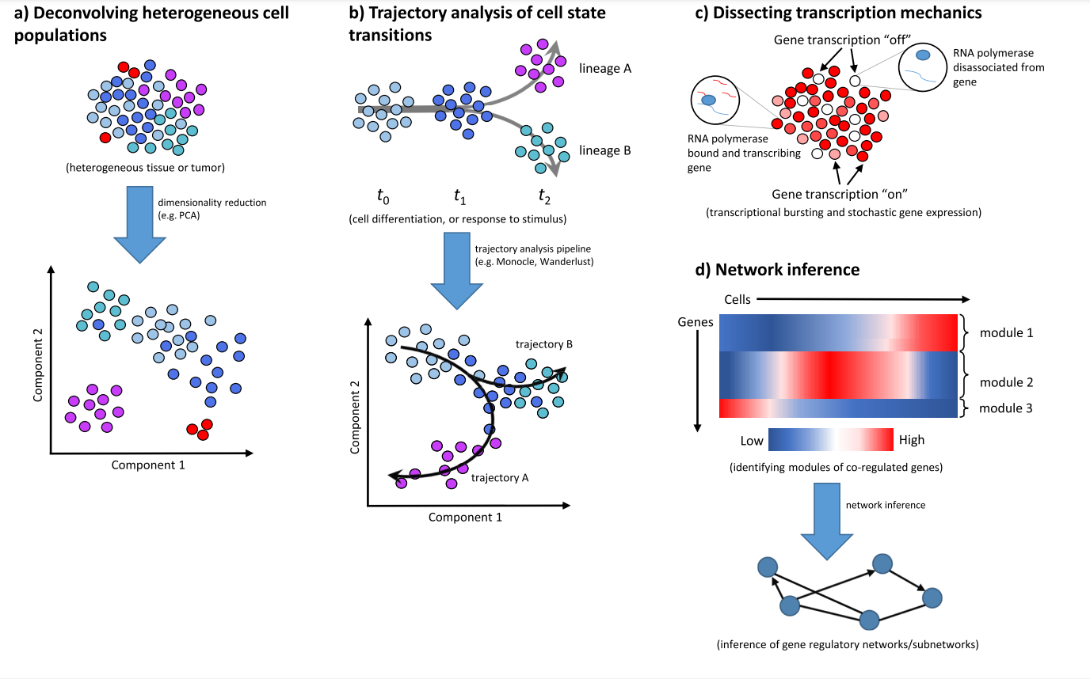
Applications of Single Cell RNA-Seq
Liu, 2016; 5: F1000 Faculty Rev-182.c
Notes:
https://www.ncbi.nlm.nih.gov/pmc/articles/PMC4758375/

Slide 6
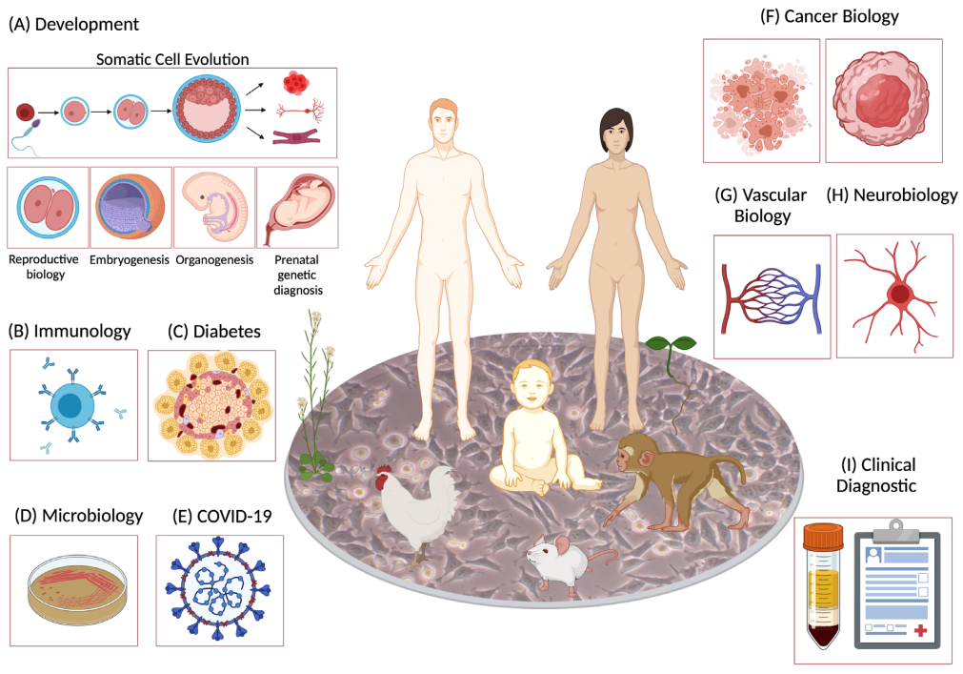
Applications of Single Cell RNA-Seq
Liu, 2016; 5: F1000 Faculty Rev-182.c
Notes:
https://www.ncbi.nlm.nih.gov/pmc/articles/PMC4758375/

Slide 7
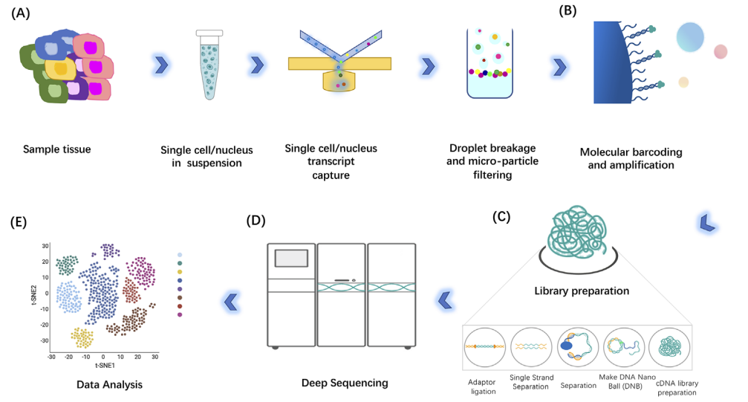
Basic single cell RNA-Seq Workflow
Liu, 2016; 5: F1000 Faculty Rev-182.
Notes:
https://www.ncbi.nlm.nih.gov/pmc/articles/PMC4758375/

Slide 8
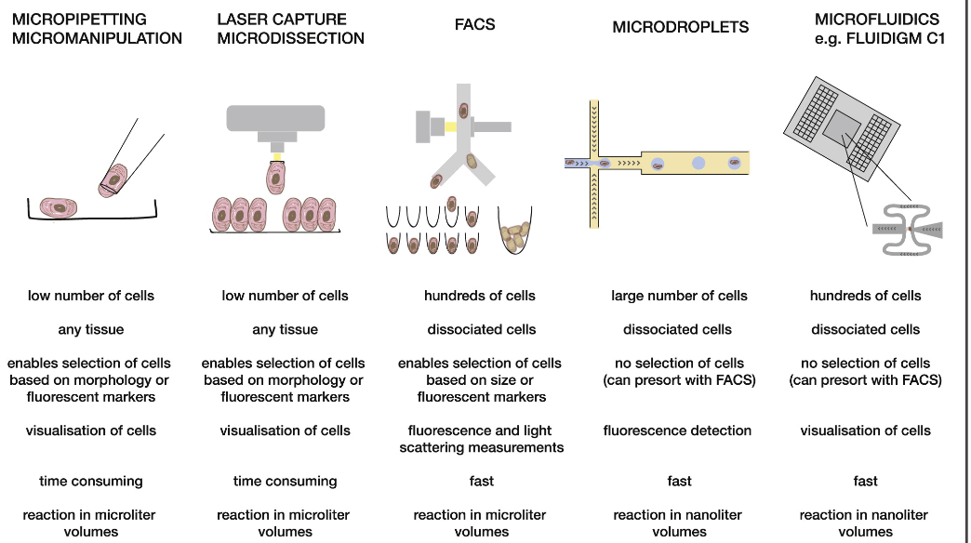
scRNA-Seq Technologies
Liu, 2016; 5: F1000 Faculty Rev-182.c
Notes:
https://doi.org/10.1016/j.molcel.2015.04.005

Slide 9
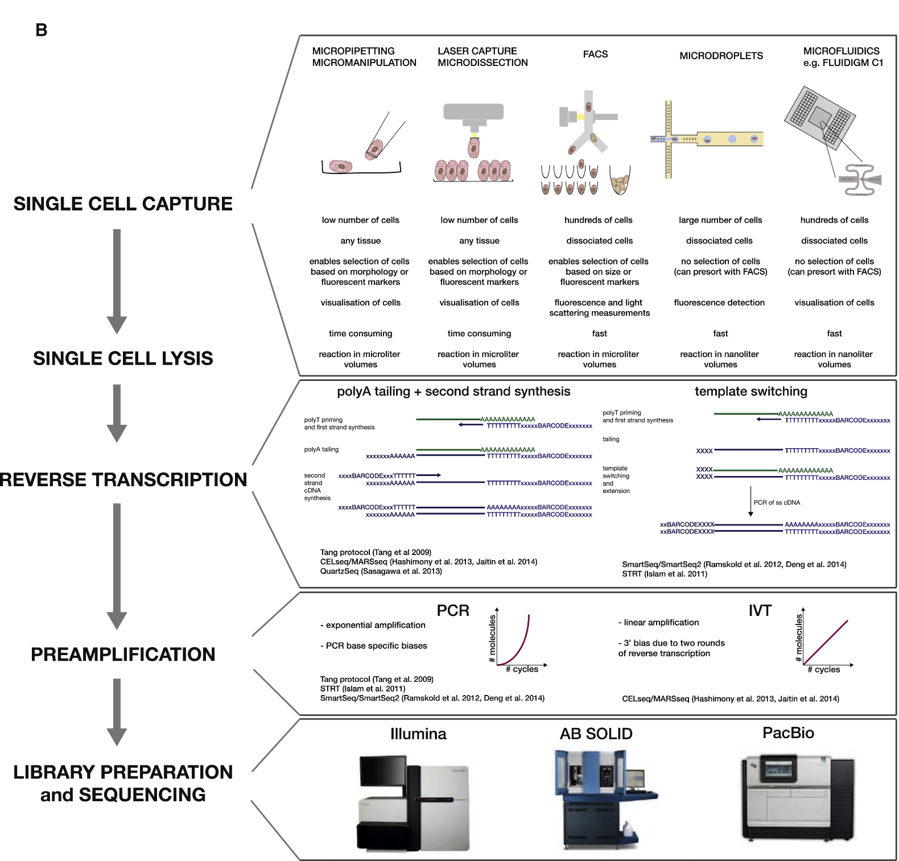
scRNA-Seq Technologies
Liu, 2016; 5: F1000 Faculty Rev-182.c
Notes:
https://doi.org/10.1016/j.molcel.2015.04.005

Slide 10
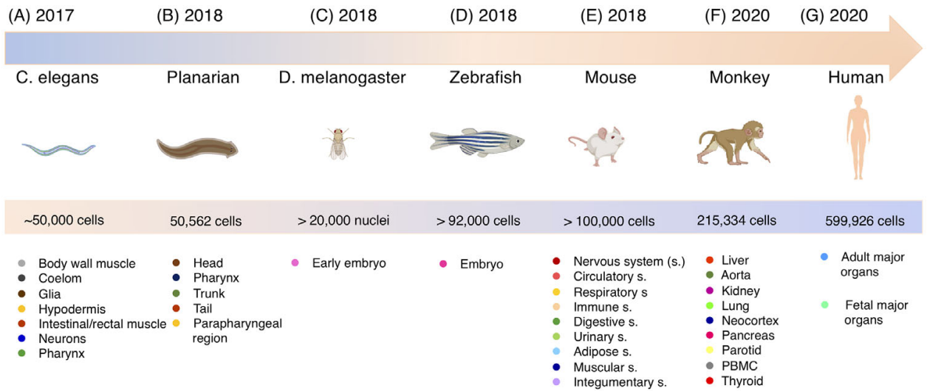
Continuous Development of Larger Atlas Datasets
Liu, 2016; 5: F1000 Faculty Rev-182.
Notes:
https://www.ncbi.nlm.nih.gov/pmc/articles/PMC4758375/

Slide 11
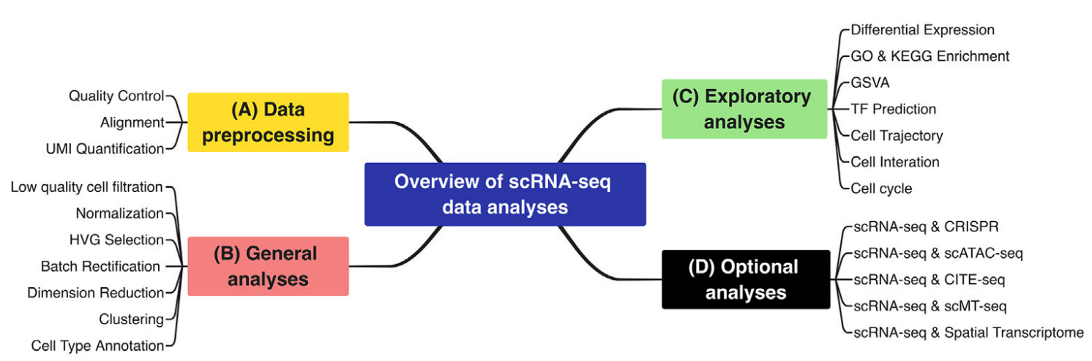
Liu, 2016; 5: F1000 Faculty Rev-182.c
Notes:
https://www.ncbi.nlm.nih.gov/pmc/articles/PMC4758375/

Slide 12
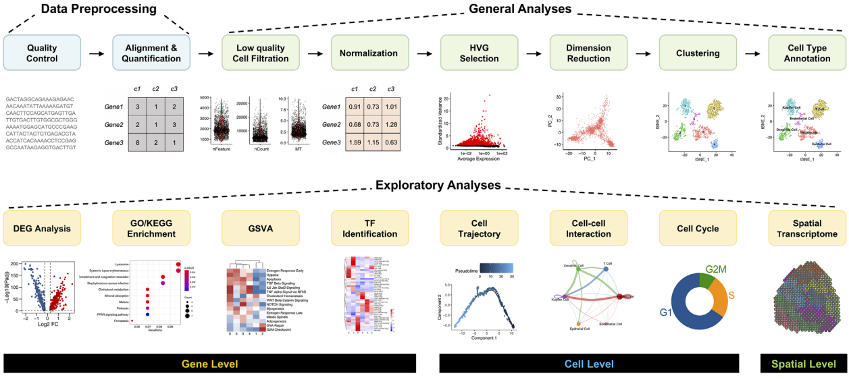
scRNA-Seq Workflow
Liu, 2016; 5: F1000 Faculty Rev-182.c
Notes:
https://www.ncbi.nlm.nih.gov/pmc/articles/PMC4758375/

Slide 13
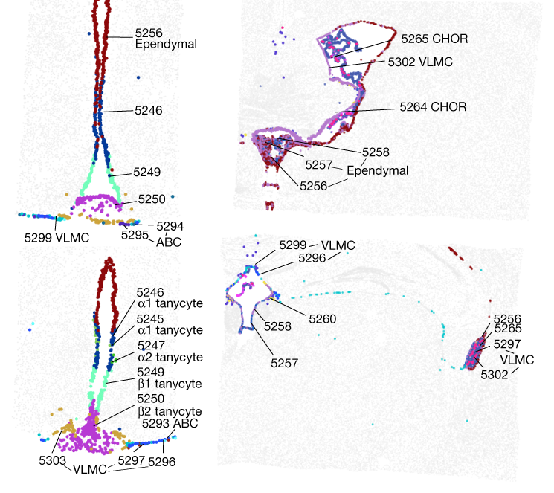
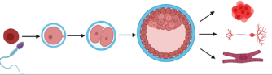
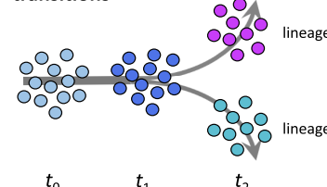
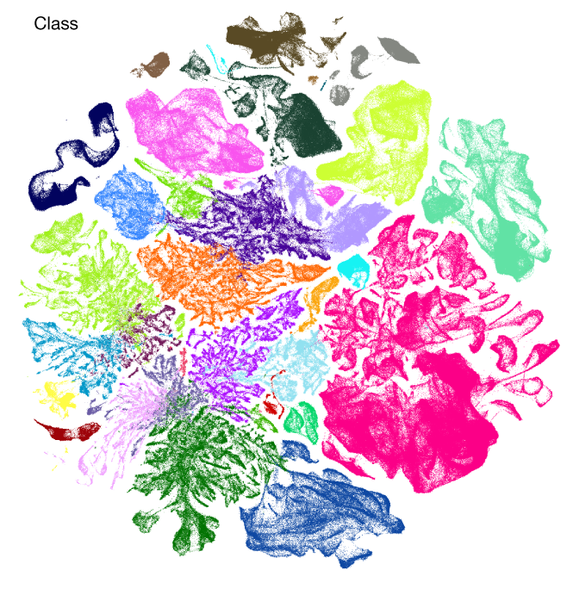
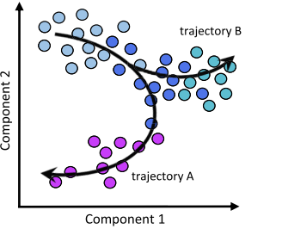
Questions?
Advances and Popularity
Questions and Applications
scRNA-Seq Experiment Workflow
scRNA-Seq Technologies
scRNA-Seq Computational Workflow
Atlas Datasets
Yao. Nature: (2023) 624, 317–33.

Slide 14


Processing Pipeline Overview
Raw Binary
Sequence
Demultiplexed Reads
Aligned Reads
Filtered feature-
barcode matrices
BCL
FastQ
BAM
SFF
Reference
Genome
VCF
HDF5
GTF
QC
GFF
Seurat
Normalization
and Scaling
Dimensionality
Reduction
Importation
Enrich Metadata
Filtering
Marker Identification
Differential Gene
Expression
Biological
Interpretation
Visualization
Clustering
Notes:
https://www.dreamstime.com/stock-illustration-dna-vector-illustration-human-structure-image49975743

